Slide 1
Building web apps that visualize large datasets
Please leave artwork “+” clustered.
Do not use them alone, as bullet points, or as a “plus” concept. Thank you.
Kristian Ekenes
@kekenes
GeoDev Webinar | Friday, May 29, 2020 | 9:00 a.m. PDT

Slide 2

Submit questions here
Notes:
Show the playground here

Slide 3
Building web apps that visualize large datasets
Please leave artwork “+” clustered.
Do not use them alone, as bullet points, or as a “plus” concept. Thank you.
Kristian Ekenes
@kekenes
GeoDev Webinar | Friday, May 29, 2020 | 9:00 a.m. PDT

Slide 4
Overview
Initial considerations
What the JS API and ArcGIS Online do for you
Optimizing your apps and data for better performance
Visualization Techniques
Scale-dependent filtering
Clustering
Data prep/processing
Reducing/generalizing features and attributes
Aggregation
Notes:
Show the playground here

Slide 5
Considerations before you start development

Slide 6
Considerations before you start development
Know your audience
Just a few specialized users?
Public or private?
Potential to go viral?
Devices
Desktop only?
Mobile and tablets
Generalization
Choose an appropriate geometry type for scale
Reduce number of features
Reduce vertices
Notes:
Show the playground here

Slide 7
Behind the scenes
What the JS API & ArcGIS Online do for you

Slide 8
Feature Tiles
Efficient, flexible, and scalable way to bring data
to the client

Slide 9
Dynamic Feature Tiles
Feature Service query
Feature Service tiled query
Client
Client
Response
Responses
Request
Requests
level: {…}
row: {…}
column: {…}
geometry: {…}
where: {…}
outFields: {…}
level: {…}
row: {…}
column: {…}
level: {…}
row: {…}
column: {…}
geometry: {…}
where: {…}
outFields: {…}
...
...
Features
(JSON)
Features (in tiles)
(JSON)
query
query
Feature Service
Feature Service

Slide 10
Public Layer
Private Layer
Query is sent to the feature layer
Feature
layer
Query is sent to the feature layer
Does the browser cache have the latest data ?
Browser
cache
Does the browser cache have the latest data ?
No
CDN
cache
Does the CDN cache have the latest data ?
No
No
Feature
tile cache
Does the feature tile cache have the latest data ?
Does the feature tile cache have the latest data ?
No
No
Execute a new query.
Data
Execute a new query.

Slide 11
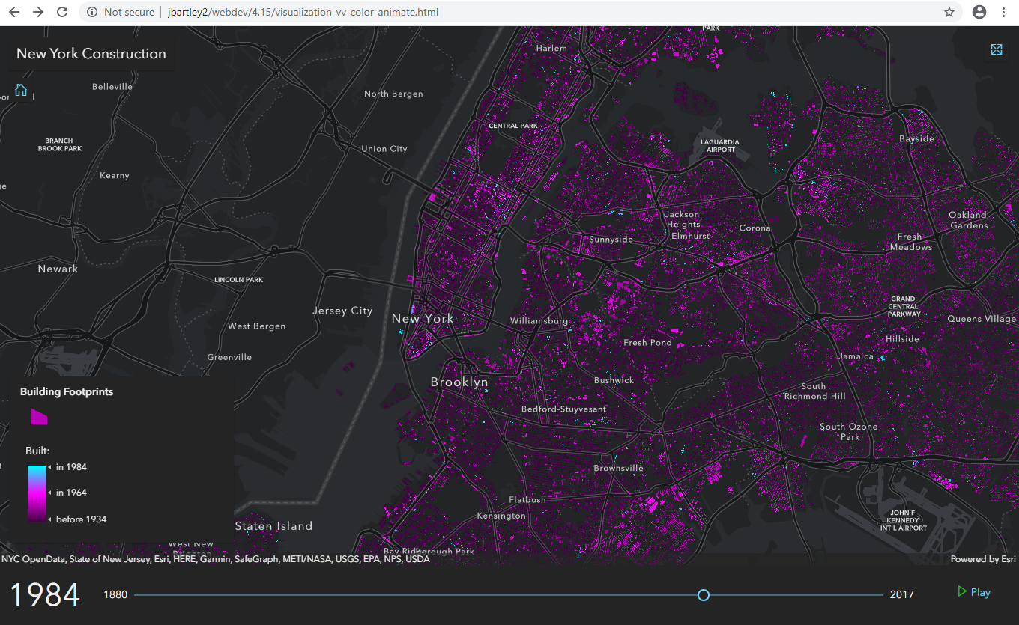
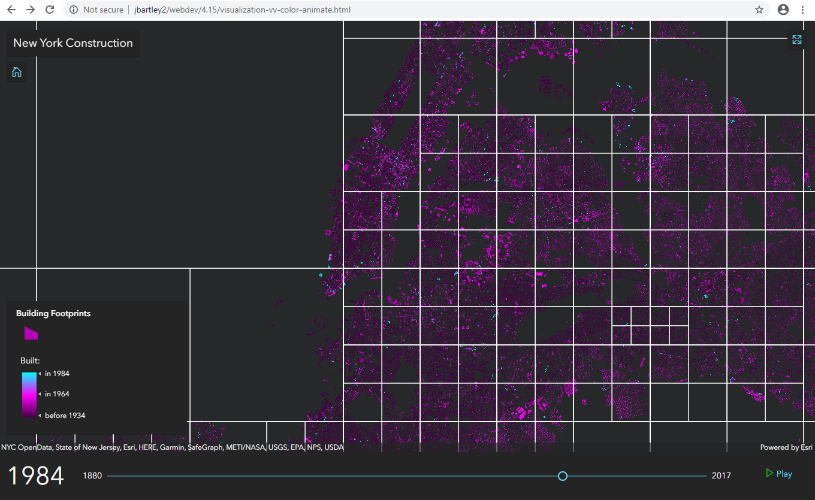
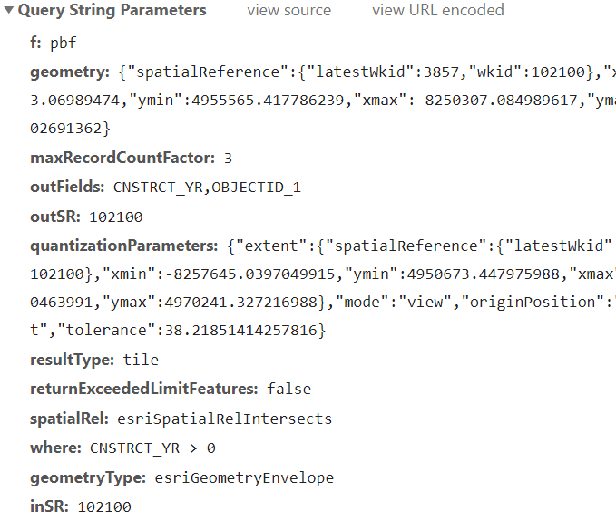
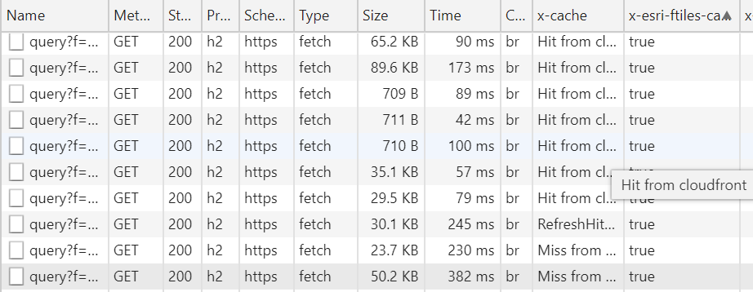
941,874 polygons
drawn on the view
Query for data one tile
at a time

Slide 12
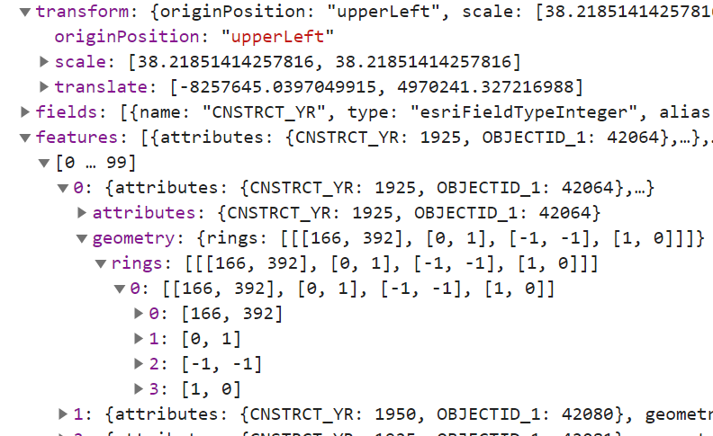
Data structure returned from feature tile query is highly efficient

Slide 13

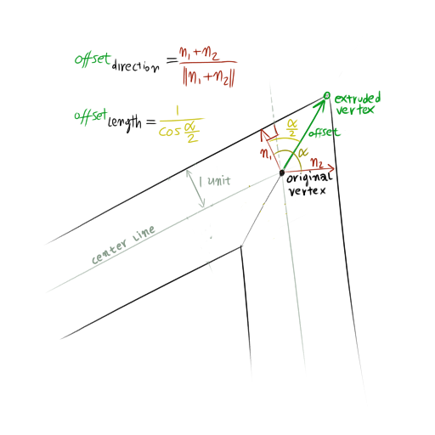
Efficiently process and prepare features to be drawn on the graphics card

Slide 14
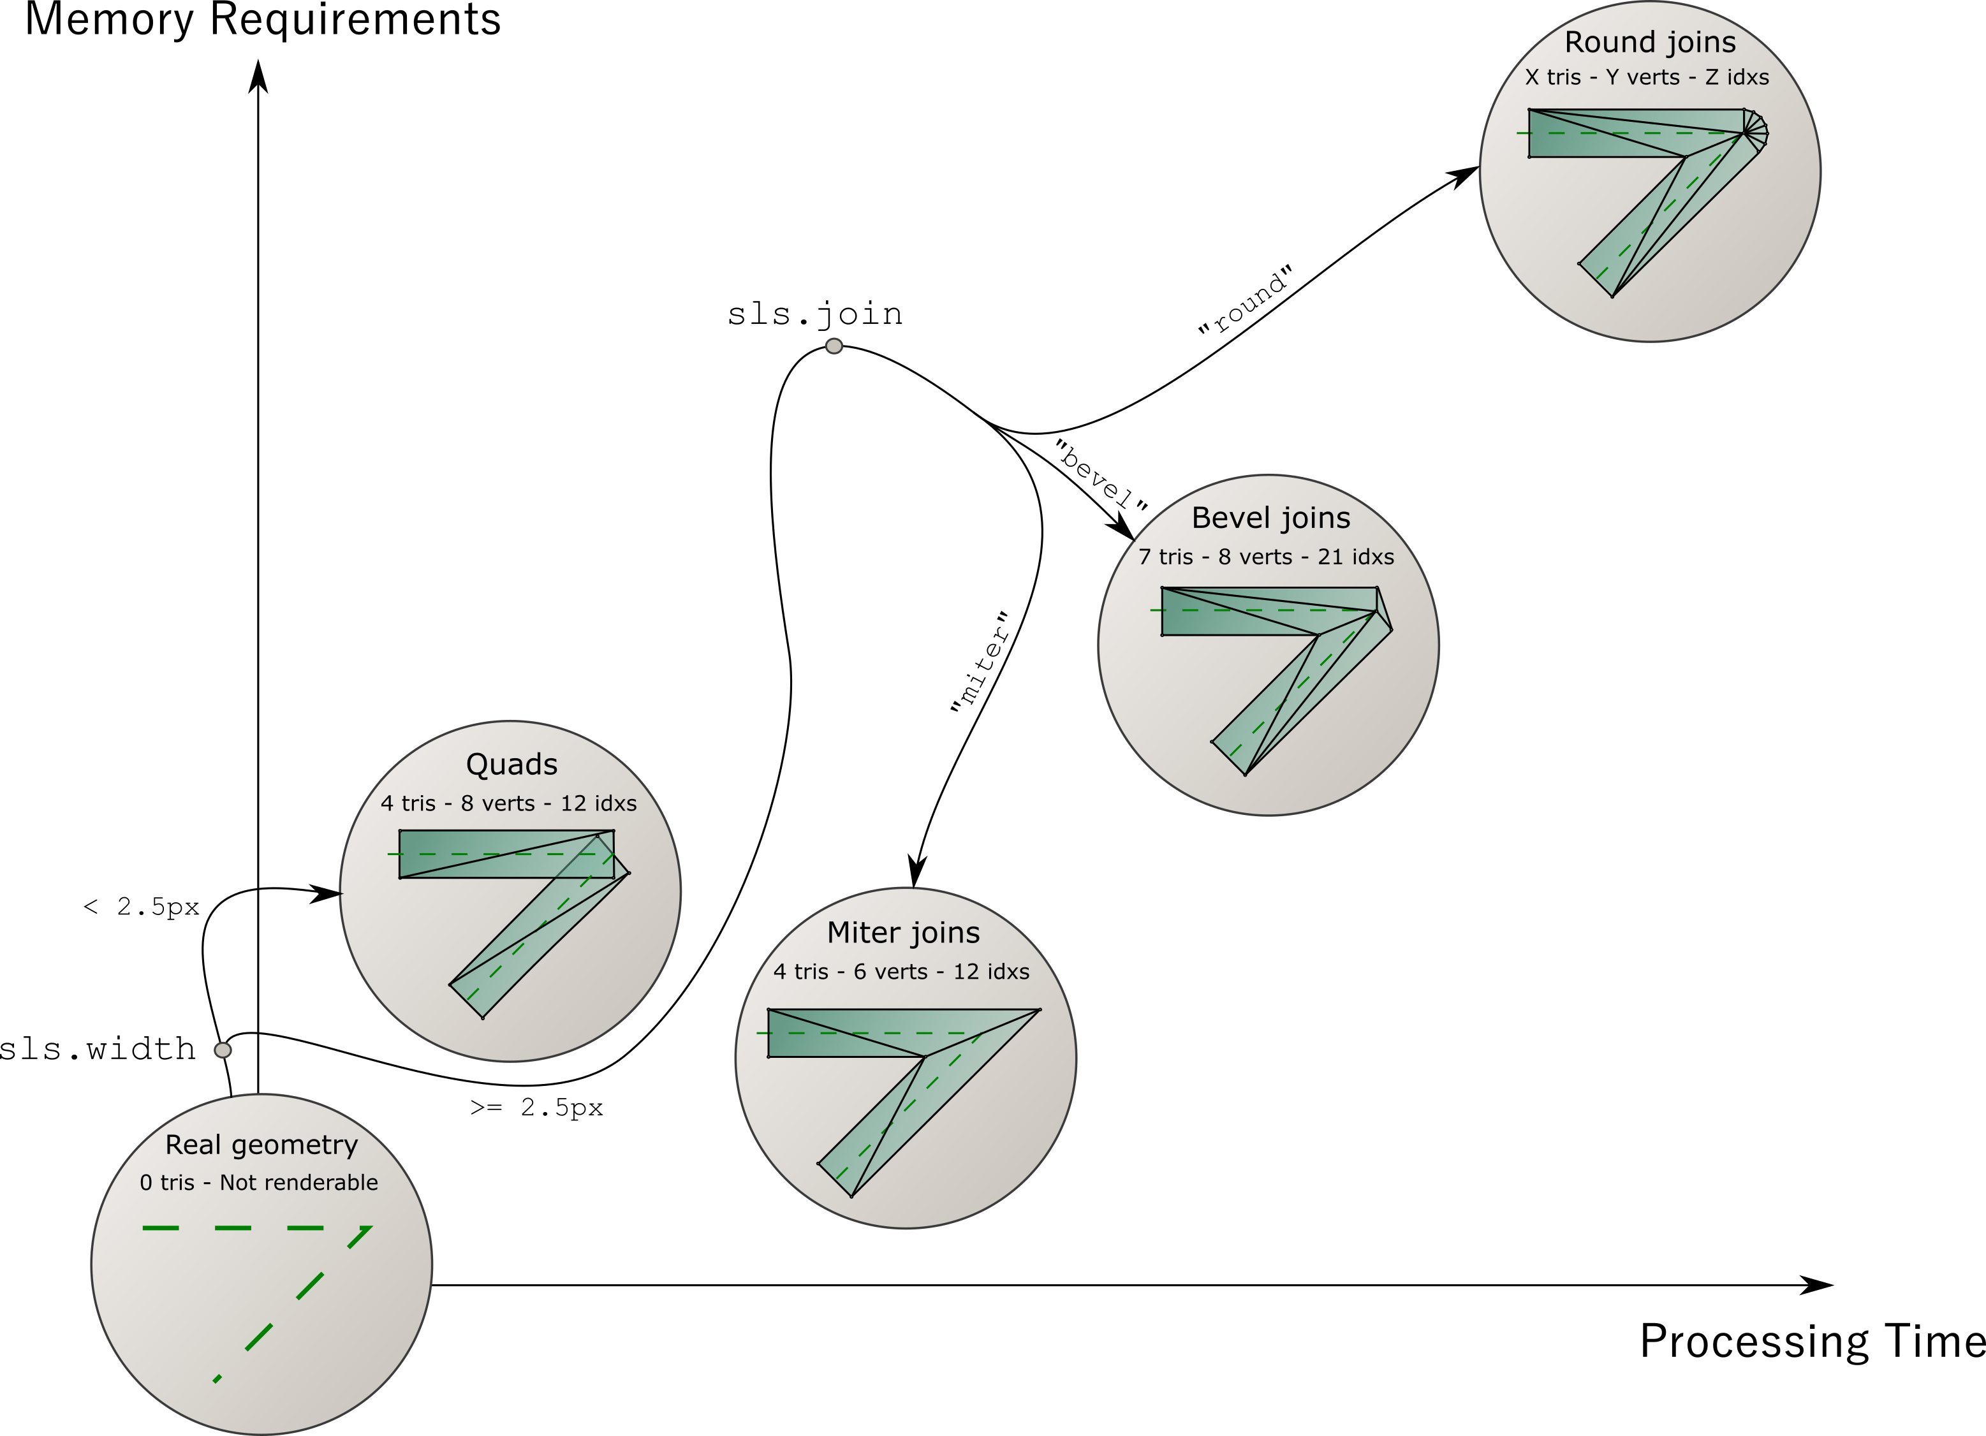
Line optimizations: balancing display quality with overall performance

Slide 15
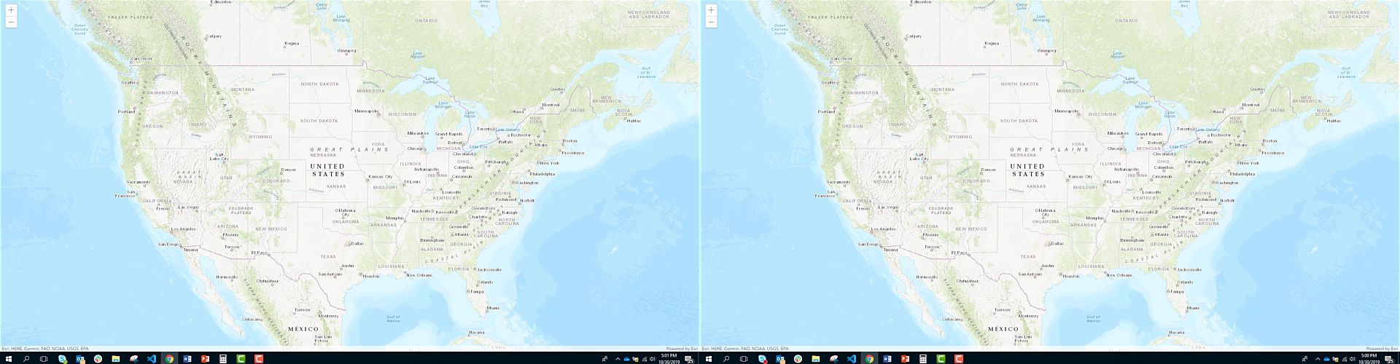
Feature layer performance continually improves
30,696 zip code polygons: 32.8% faster load
Improvements to speed, accuracy and memory profile
Improved triangulation processing
Faster lines
4.9
4.13

Slide 16

Feature layer performance continually improves
dev
4.15

Slide 17
What you can do
Optimize your apps for better performance and understanding

Slide 18
Visualization techniques
Scale-dependent filtering

Slide 19
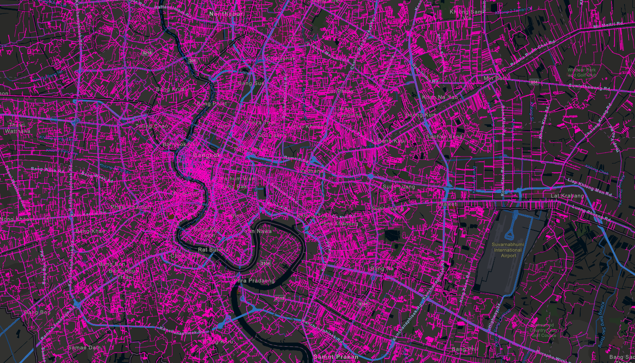

Water distribution pipes

Slide 20
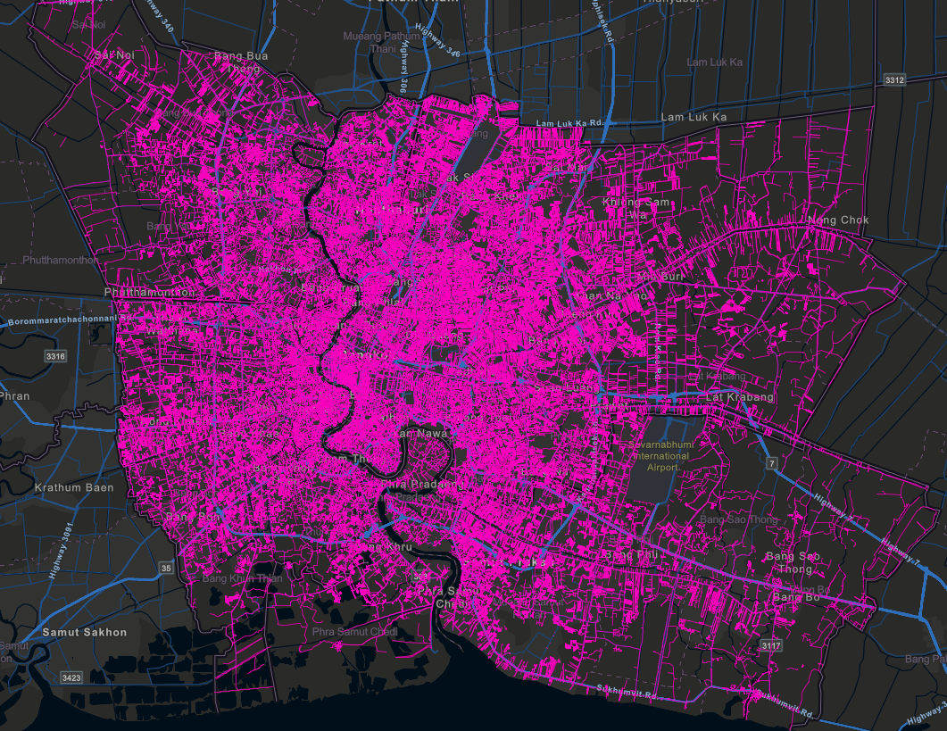
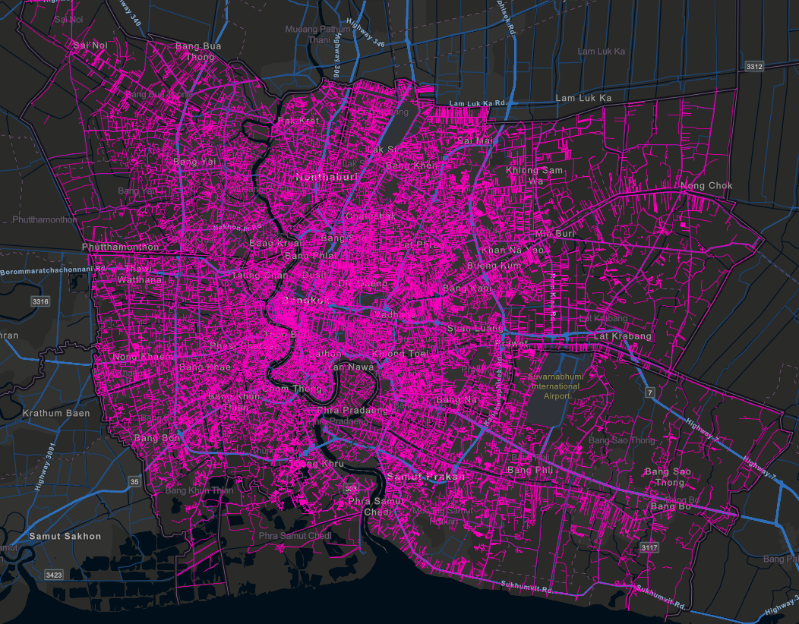
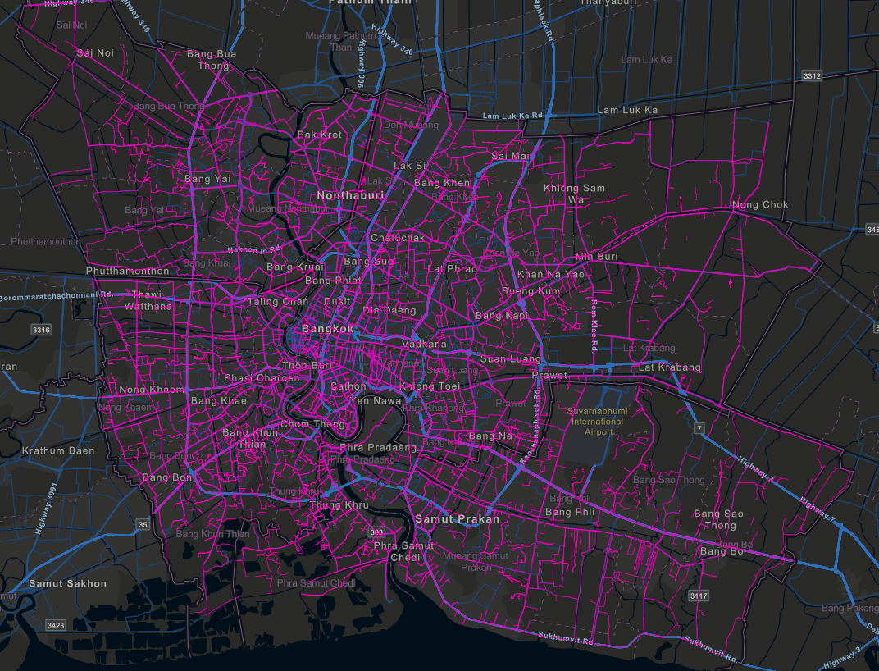


Filter by scale using attributes
No filter
17.7 MB (uncompressed)
~7s (desktop on fast network)
Filter: pipe_size >= 150
14.7 MB (uncompressed)
~5s (desktop on fast network)
Filter: pipe_size >= 300
11.2 MB (uncompressed)
~3s (desktop on fast network)
550,578 features
358,921 features
Still 107,256 features!
Notes:
Show the playground here

Slide 21
Visualization techniques
Clustering

Slide 22
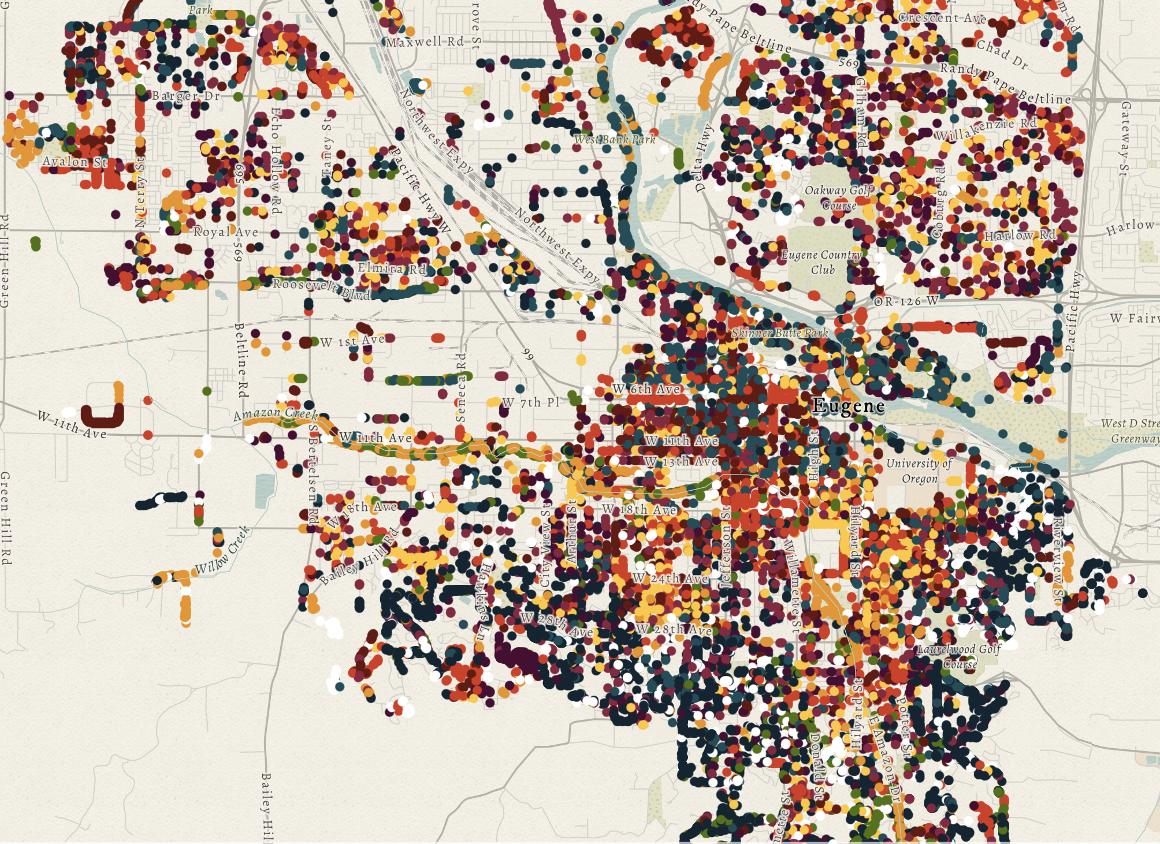
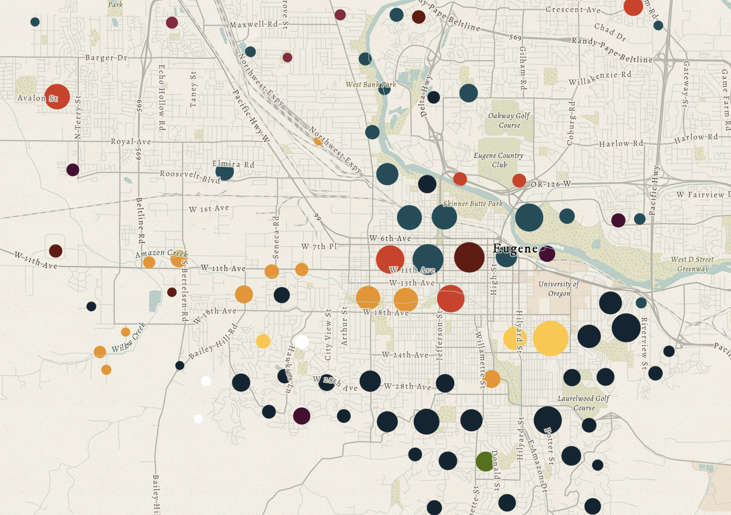
Clustering

Slide 23
Data prep and processing

Slide 24
Data prep and processing
Restructure your data (e.g. table pivots)
Generalize geometries
Thin geometries
Remove unnecessary attributes

Slide 25
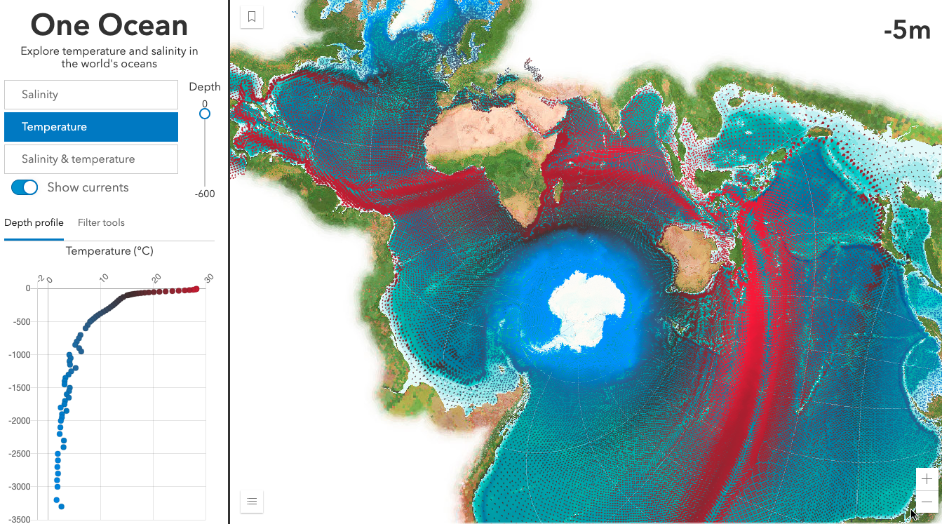
One Ocean
Kristian Ekenes

Slide 26
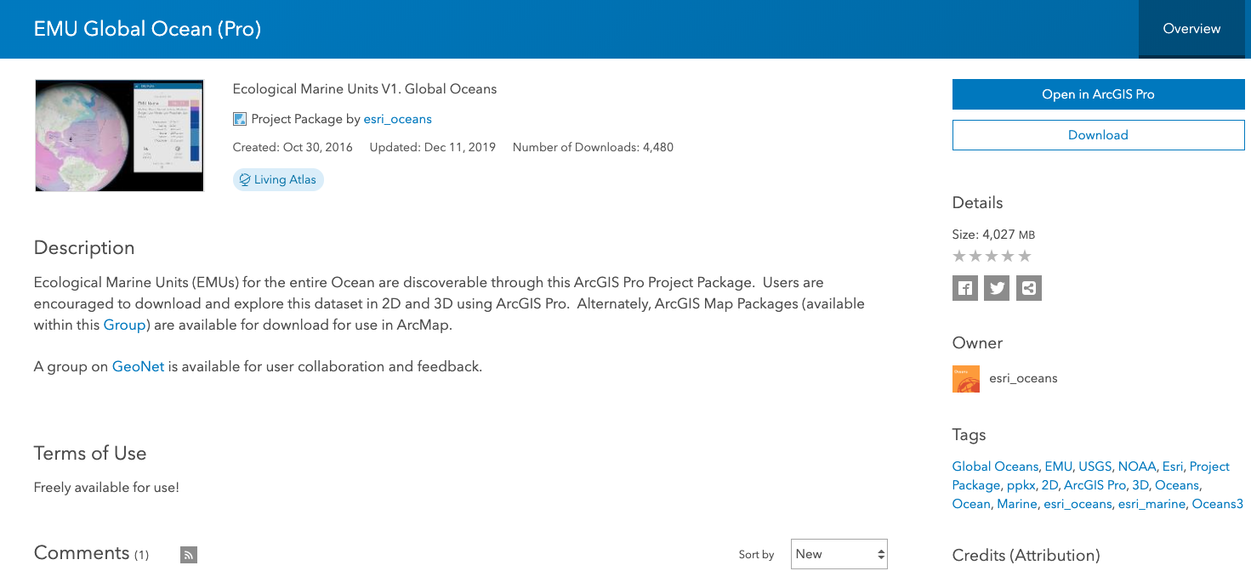

Notes:
Show the playground here

Slide 27
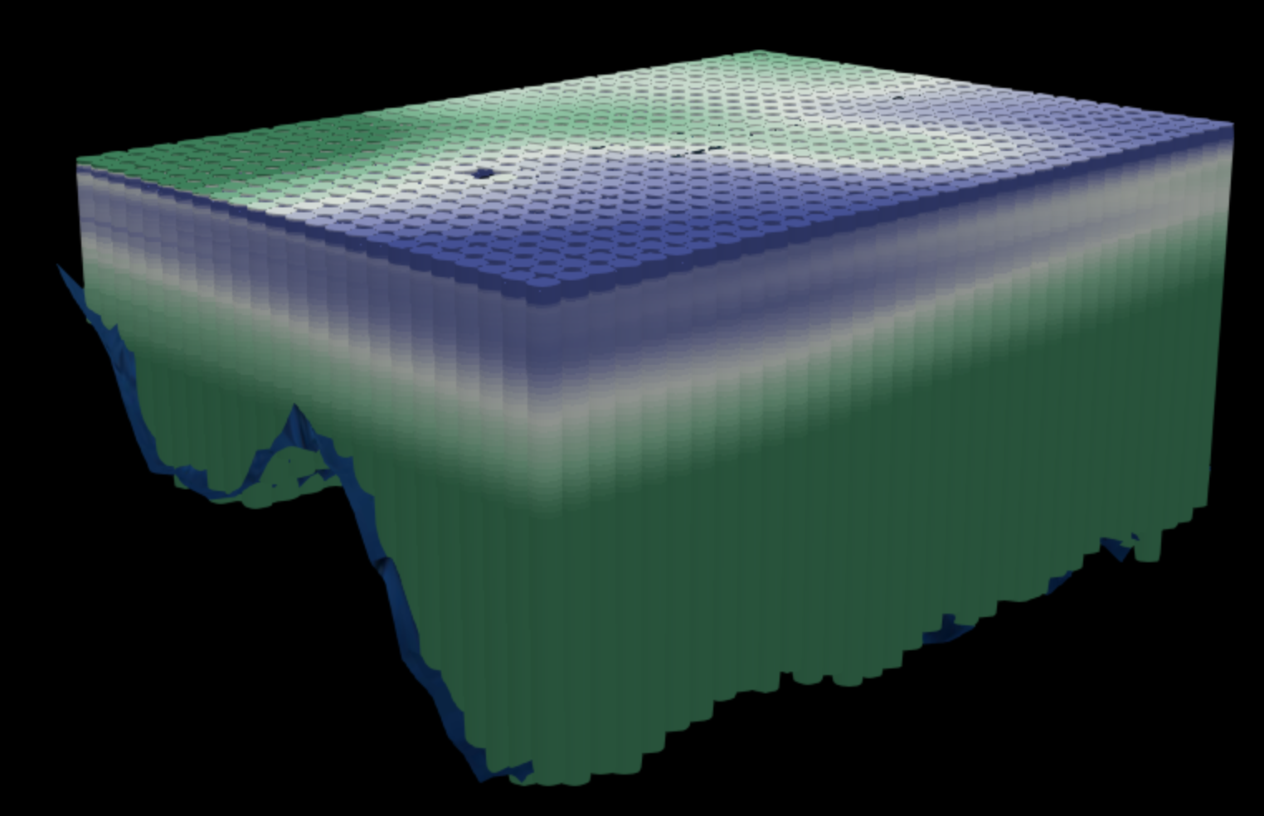

Goal: get the total download as small as possible
Know your data!
52 million points!
> 4 GB of data
Points at every ¼ degree of lat/lon
Up to 102 points stacked at each location (from surface to ~5,000m depth)
12 attributes per point (temperature, salinity, phosphate, silicates, EMU cluster, etc.)
Notes:
Show the playground here

Slide 28
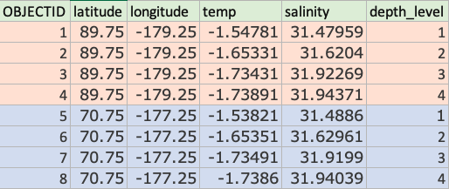
Goal: get the total download as small as possible
Step 1: Restructure data
One point per x,y location
Flatten the table
spatial join or
table pivot
Reduced number of points to 677,109 features. Data is now one row per x,y location with fields for each attribute at each depth level.
New problem – Now we have 1,224 fields.
Notes:
Show the playground here

Slide 29
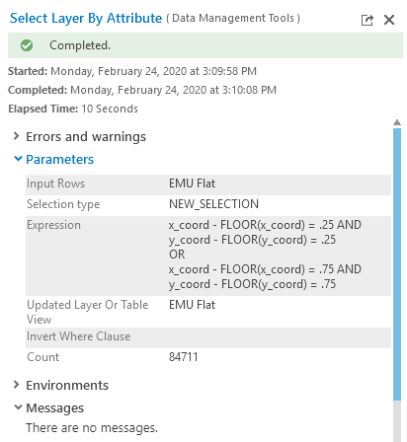
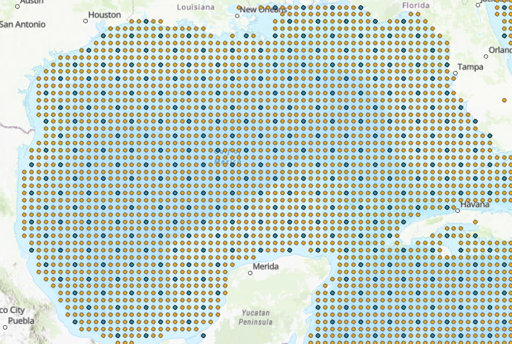
Goal: get the total download as small as possible
Step 2: Generalization
Geometry thinning
Thin points to every ½ degree ( ¼ degree resolution is too high for worldwide views)
Reduced number of points to 84,711 features! A reasonable number to work with.
Notes:
Show the playground here

Slide 30
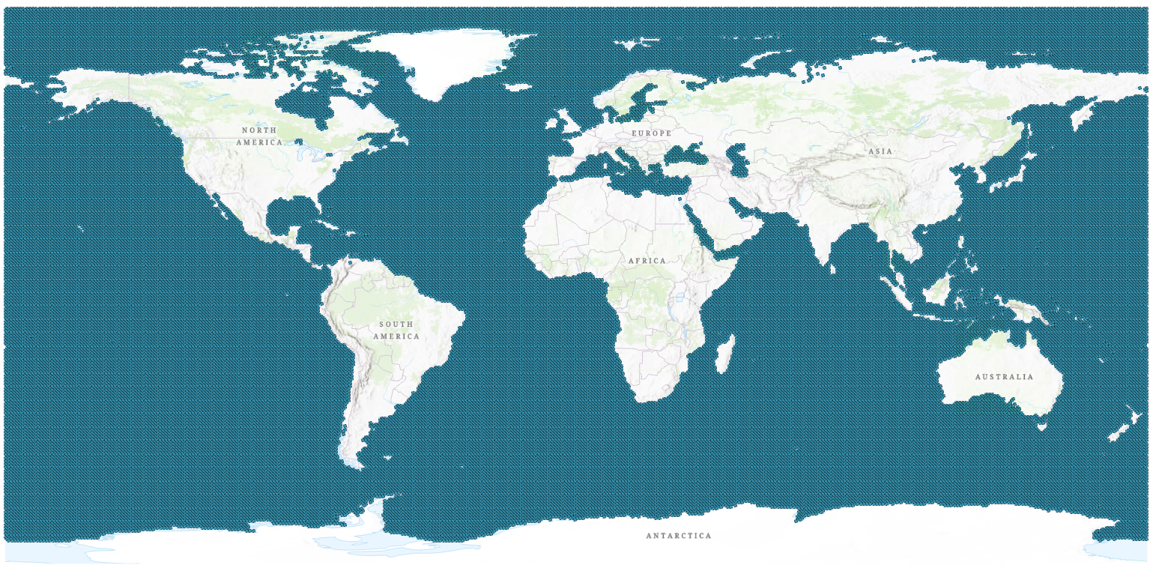
Goal: get the total download as small as possible
Notes:
Show the playground here

Slide 31
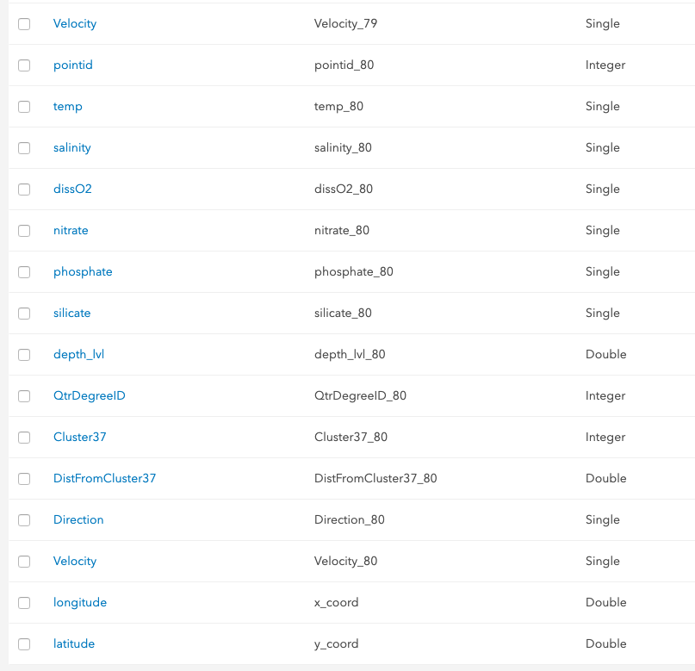
Goal: get the total download as small as possible
Step 3: Reduce columns
Attribute thinning
Feature Services limit you to 1,024 fields.
I removed ~300 fields and was able to publish the service.
Remaining problems:
960 fields is still too much data to work with on the client.
Setting outFields to one attribute for every depth level results in huge query string requiring the POST method (not cacheable)
Notes:
Show the playground here

Slide 32
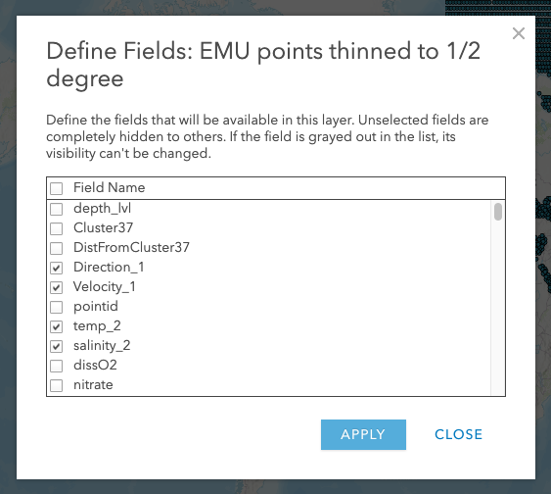
Goal: get the total download as small as possible
Step 3: Reduce columns
Attribute thinning
Create hosted Feature View and restrict fields to only the ones you need.
Now we have ~300 fields (useable)
Queries can request outFields using [“*”], which can be cached.
Set maxAge on tiles to 1 hour.
Now we have a manageable dataset we can work with in the browser!
Notes:
Show the playground here

Slide 33
Goal: get the total download as small as possible
Step 3: Reduce columns
Attribute thinning
If you can’t afford to drop values, you can create a list of separated values in a single column or set of columns…
Notes:
Show the playground here

Slide 34
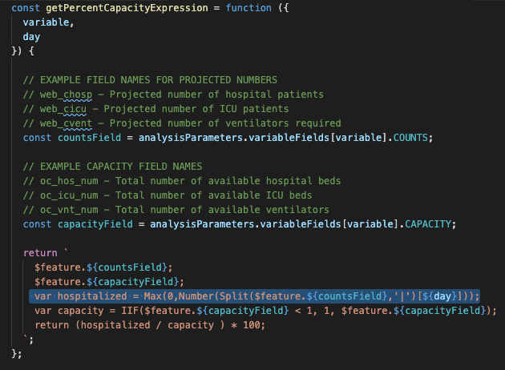
Notes:
Show the playground here

Slide 35
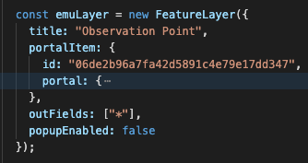
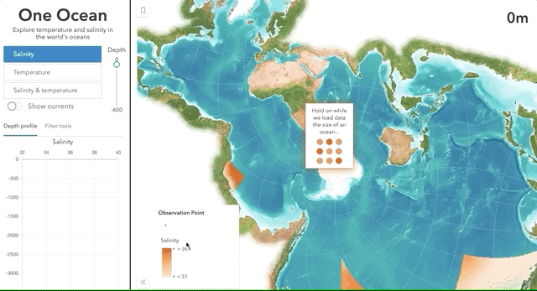
Goal: get the total download as small as possible
Step 4: Request data up front
For client-side goodness
Now we have a manageable dataset we can work with in the browser!
Costs:
Still loads 280 MB of data!
Not useable for mobile devices
Initial load time is longer, but…
UX is a lot nicer once the data loads.
Notes:
Show the playground here

Slide 36
Conclusion
The ArcGIS platform does a lot behind the scenes to optimize your data and apps when loading large amounts of data, but
YOU can do more to optimize your apps and data for better performance
Visualization Techniques
Scale-dependent filtering
Clustering
Data prep/processing
Reducing/generalizing features and attributes
Aggregation
Notes:
Show the playground here

Slide 37
Additional Resources
Apps and data
One Ocean app
One Ocean hub
Dev Summit 2020 data and slides
Related articles
Mapping large datasets on the web
Scalable hosted feature layers in ArcGIS Online: Tile queries and response caching
Enhancements for mapping more data, more efficiently in the browser
Notes:
Show the playground here

Slide 38


